Slide 1
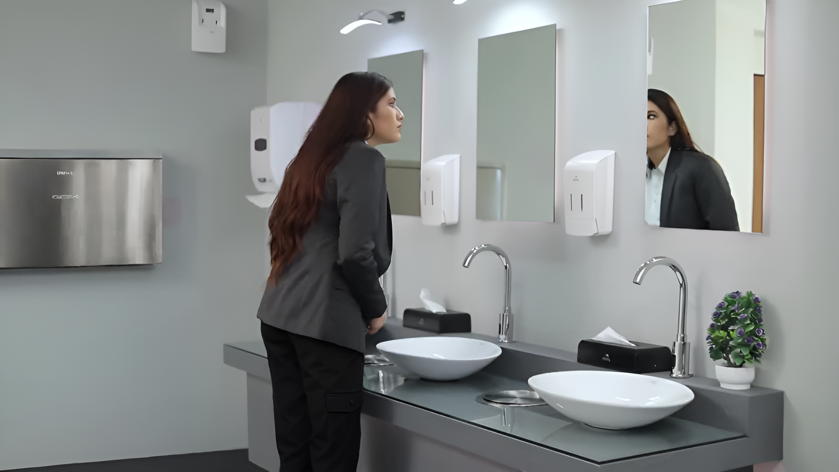
Two Decades of Excellence: The Strategic Partnership between Flair Plastic Ltd. and Kennedy Hygiene
For over two decades, Flair Plastic Ltd. and Kennedy Hygiene have maintained a strategic partnership, centered on the development and manufacturing of integrated washroom hygiene systems. This enduring collaboration has driven significant benefits for both companies, fostering product innovation and operational excellence.

Slide 2
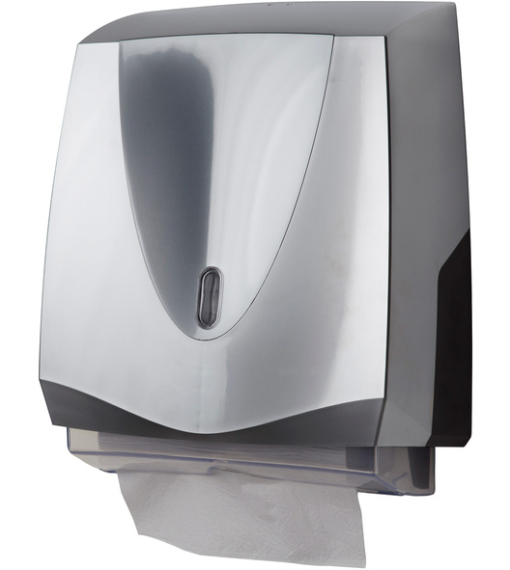
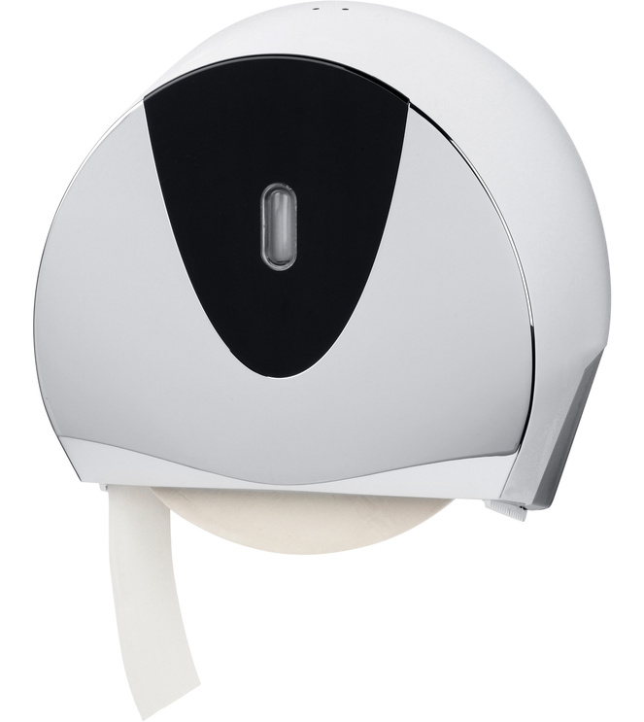
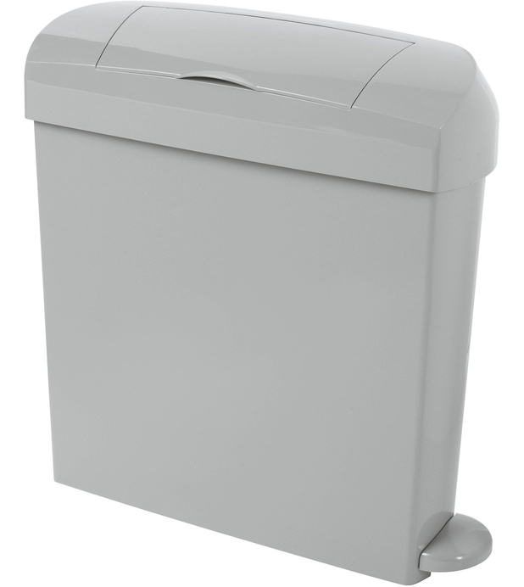
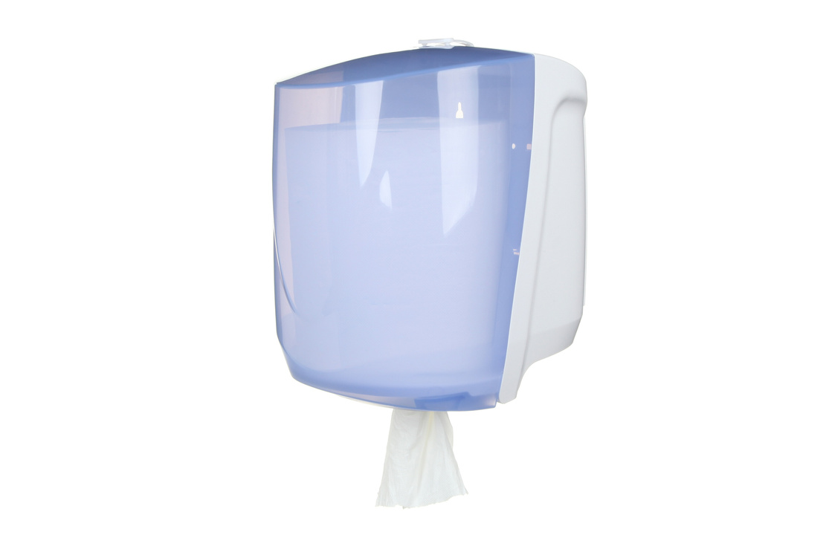

The collaboration primarily focuses on integrated washroom hygiene systems, offering comprehensive solutions tailored to diverse washroom and hygiene needs. Leveraging its expertise in plastic injection molding, Flair Plastic delivers high-quality, durable products that meet the stringent standards set by Kennedy Hygiene
Key Products and Services

Slide 3
Benefits of the Partnership
Logistics and Support
Streamlined Logistics: Flair Plastic's dedicated sales support team efficiently organizes transportation and customs clearance for third-country shipments. This logistical support has been crucial in ensuring Kennedy Hygiene’s operations run smoothly, minimizing delays, and reducing operational costs.
Inventory Management
Efficient Stock Control: With an extensive storage capacity of 15,000m², Flair Plastic adeptly manages inventory, ensuring rapid response to sudden order increases and maintaining a steady supply chain. This capacity allows Kennedy Hygiene to meet customer demands promptly, enhancing customer satisfaction and loyalty.
3. Communication and Coordination
Weekly Alignment Meetings: Regular meetings facilitate real-time monitoring of large order volumes, allowing both companies to flexibly reorganize orders in response to changing customer demands. This level of communication ensures that both companies are aligned in their goals and can quickly adapt to market changes.
4. Quality Assurance
Continuous Quality Feedback: Ongoing feedback between the quality assurance teams ensures the maintenance and enhancement of consistent quality standards. This collaborative approach to quality management has led to continuous improvements in product reliability and customer satisfaction.

Slide 4

Raw Material Procurement
Adaptable Production Planning: Procuring raw materials on time can be challenging. Flair Plastic addresses this by swiftly adjusting production plans to mitigate delays, ensuring timely order fulfillment. This proactive approach minimizes the impact of supply chain disruptions and maintains production schedules
Addressing Challenges

Slide 5
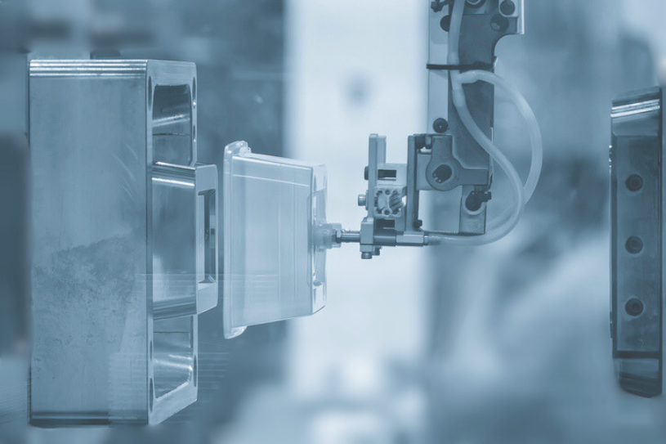
Flair Plastic significantly contributes to Kennedy Hygiene’s product innovation through professional reviews of plastic injection mold designs. This collaborative effort extends to product assembly, fostering the development of next-generation hygiene solutions. By leveraging their combined expertise, the partners have been able to introduce innovative products that set new industry standards.
Innovation and Development

Slide 6

The partnership is committed to sustainability, implementing several initiatives, including:
Recycled Materials: Incorporation of recycled materials in production processes to reduce environmental impact.
Bulk Procurement: Purchasing raw materials in bulk to minimize waste and lower costs.
Optimized Order Quantities: Setting larger order quantities to enhance efficiency and reduce environmental impact. These initiatives not only improve the sustainability of the production process but also demonstrate a commitment to environmental stewardship.
Sustainability Initiatives

Slide 7

Market Trends
Kennedy Hygiene’s strong market position has resulted in a steady increase in order volumes, providing a stable business contribution. This growth underscores the strength of the partnership and enhances the competitive edge of both companies. The ability to scale operations efficiently has allowed both companies to capitalize on market opportunities and drive business growth.

Slide 8


Final Reflection
The long-standing partnership between Flair Plastic and Kennedy Hygiene exemplifies the power of strategic collaboration. Over the years, the companies have adeptly navigated market challenges, continuously improving their products and services. This alliance not only bolsters their market positions but also enhances their overall competitiveness. The collaboration serves as a model for how businesses can work together to achieve mutual success.

Slide 9
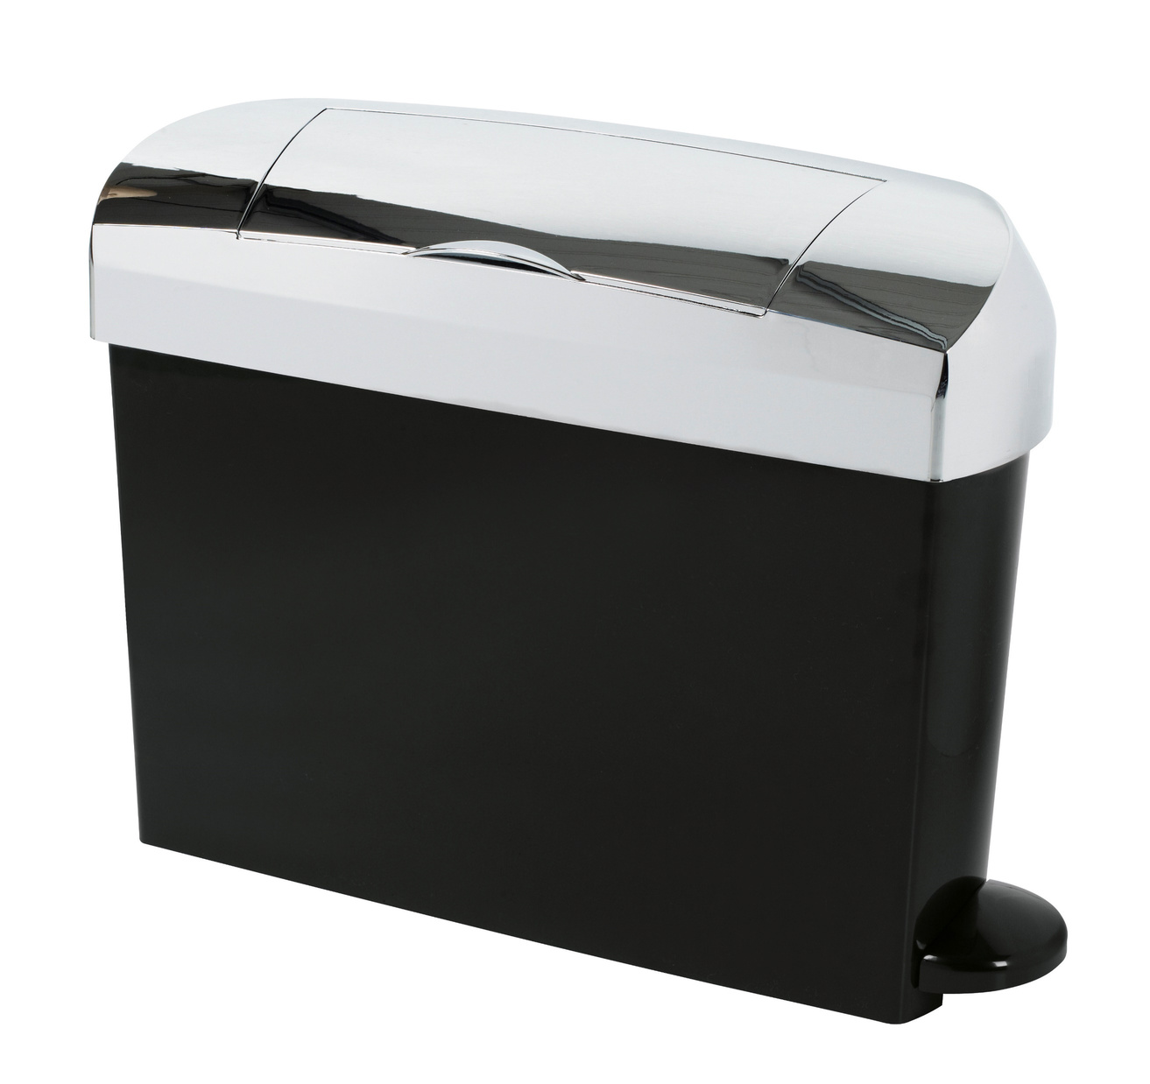
Discover how Flair Plastic's innovative solutions and strategic partnerships can benefit your business. Contact us today to learn more

